Slide 1
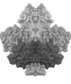
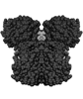
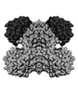
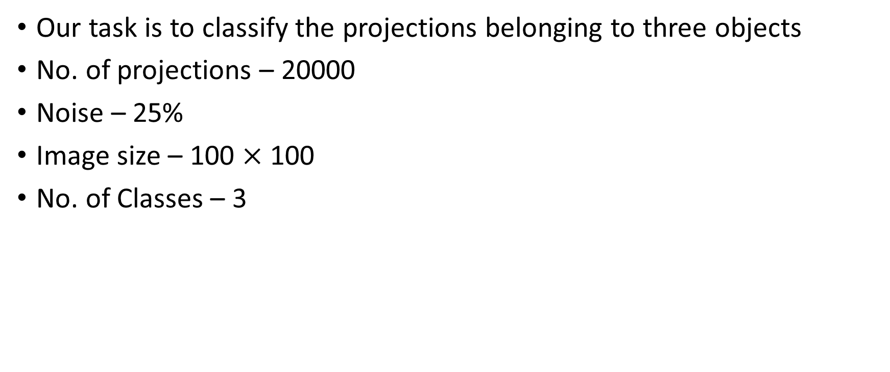
Classification of projections
Our task is to classify the projections belonging to three objects
No. of projections – 20000
Noise – 25%
Image size – 100 $×$ 100
No. of Classes – 3

Slide 2
Graph-Laplacian Based Classification
The 20000 projections are first clustered into roughly 2500 classes using Hierarchical clustering. This step is necessary as direct application of Graph Laplacian would involve taking an inverse and finding the eigenvectors of a 20000 × 20000 matrix which is infeasible.
The second advantage is that, using clustered projections leads to denoising the projection.
The reason we are using Hierarchical clustering is because in this we don’t need to specify the number of clusters. Instead we just need to specify how close should projections be in a cluster, and it decides the number of clusters on its own. This leads to much better control over the class and angle purity in a cluster.

Slide 3
Graph-Laplacian Based Classification
The clustered projections are next passed through a PCA-denoising step.
We now apply the graph Laplacian transform and plot the eigen-coefficients belonging to the top-three eigen values.
The hope is that since the graph-Laplacian transform is a distance preserving transform, we should be able to see three clusters when we plot the points.

Slide 4
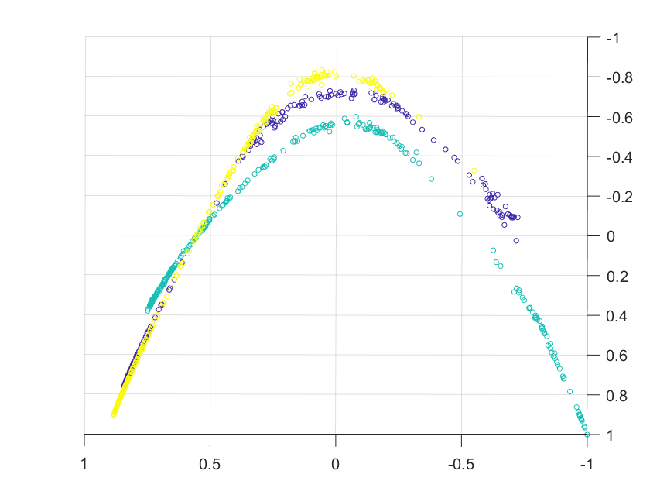
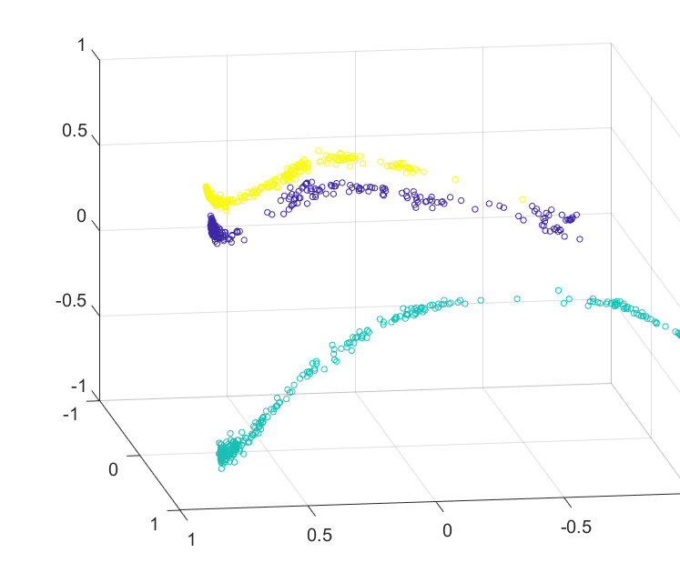
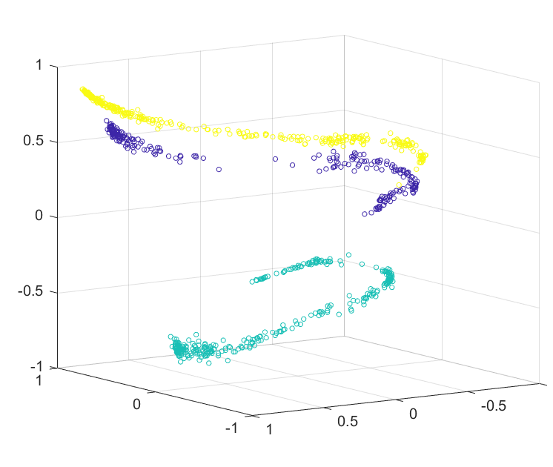
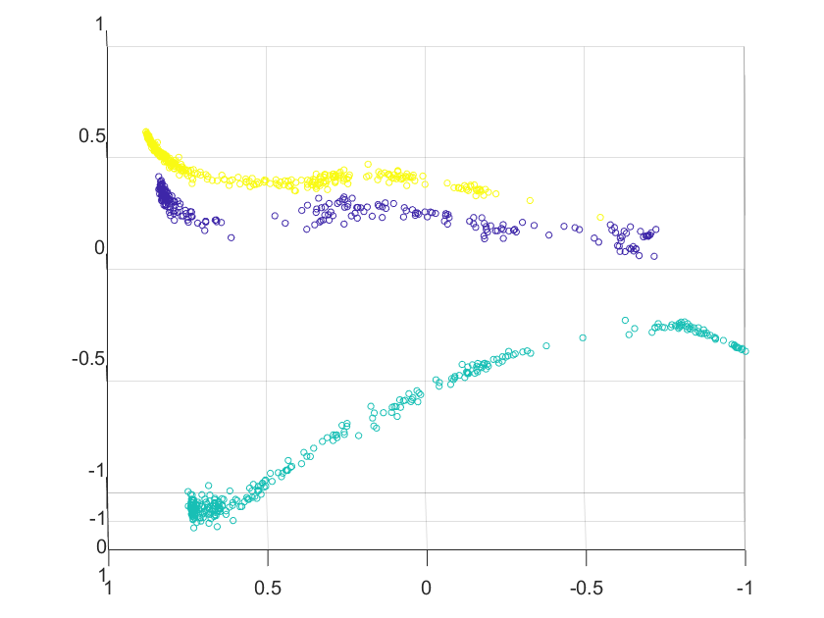
The Three Clusters showing themselves

Slide 5
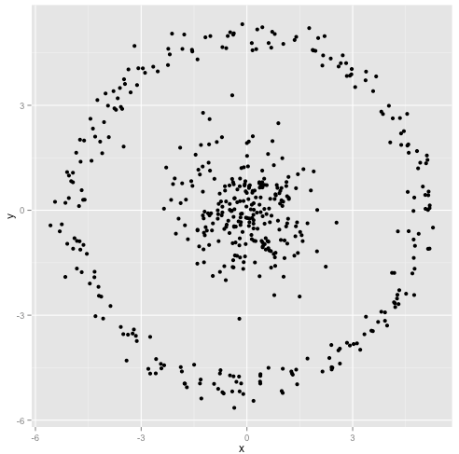
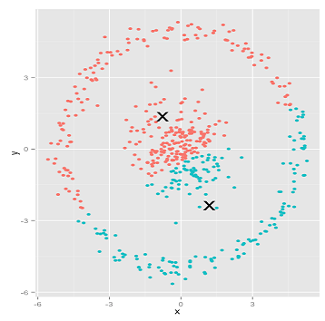
How to identify the clusters
K-means in such cases fails as it is not able to detect clusters of such shapes as demonstrated by the example below.
Looking at this image, we humans immediately recognize two natural groups of points- there's no mistaking them. However K-means produces clusters of this kind

Slide 6
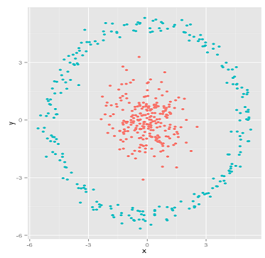
How to identify the clusters
So is there a clustering method which can identify clusters that are weirdly shaped?
Yes! Enter single linkage hierarchical clustering – One of it’s distinguishing feature is that it produces long thin clusters in which nearby elements of the same cluster have small distances, but elements at opposite ends of a cluster may be much farther from each other.

Slide 7
Does it work in our case?
Experiment 1
20000 projections
3 classes
20% noise

Slide 8
In some cases, it also fails
Experiment 2
10000 projections
3 classes
35% noise

